Slide 1
Javascript: Basics

Slide 2
Introduction
JavaScript is a scripting language most often used for client- side web development.
The JavaScript supported in the browsers typically support additional objects.
e.g., Window, Frame, Form, DOM object, etc.
Different brands or/and different versions of browsers may support different implementation of JavaScript.
They are not fully compatible
JScript is the Microsoft version of JavaScript
2

Slide 3
What can we do with JavaScript?
To create interactive user interface in a web page (e.g., menu,
pop-up alert, windows, etc.)
Manipulating web content dynamically
Change the content and style of an element
Replace images on a page without page reload
Hide/Show contents
Generate HTML contents on the fly
Form validation
AJAX (e.g. Google complete)
etc.
3

Slide 4
Why Study JavaScript?
JavaScript is one of the 3 languages all web developers must learn:
HTML to define the content of web pages
CSS to specify the layout of web pages
JavaScript to program the behavior of web pages
Web pages are not the only place where JavaScript is used.
Many desktop and server programs use JavaScript. Node.js is
the best known.
Some databases, like MongoDB and CouchDB, also use JavaScript as their programming language.
4

Slide 5
Syntax
JavaScript can be implemented using JavaScript statements
that are placed within the <script>... </script>
You can place the <script> tags, containing your JavaScript, anywhere within your web page, but it is normally recommended that you should keep it within the <head> tags.
The <script> tag alerts the browser program to start
interpreting all the text between these tags as a script.
5

Slide 6
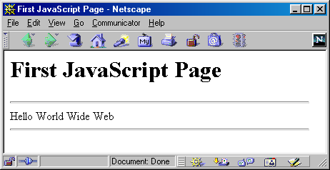
A Simple Script
Ex1.html
<html>
<head><title>First JavaScript Page</title></head>
<body>
<h1>First JavaScript Page</h1>
<script type="text/javascript"> document.write("<hr>");
document.write("Hello World from JavaScript!");
document.write("<hr>");
</script>
</body>
</html>
6

Slide 7
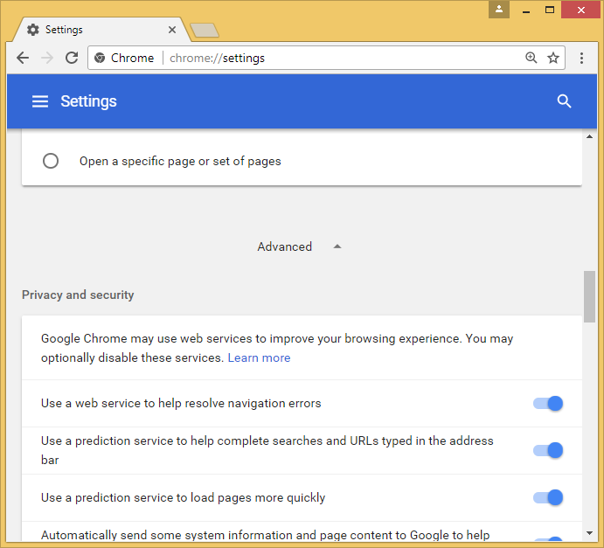
Enabling - Chrome
Step 2 : Advance Setting -> Privacy & Security
7

Slide 8
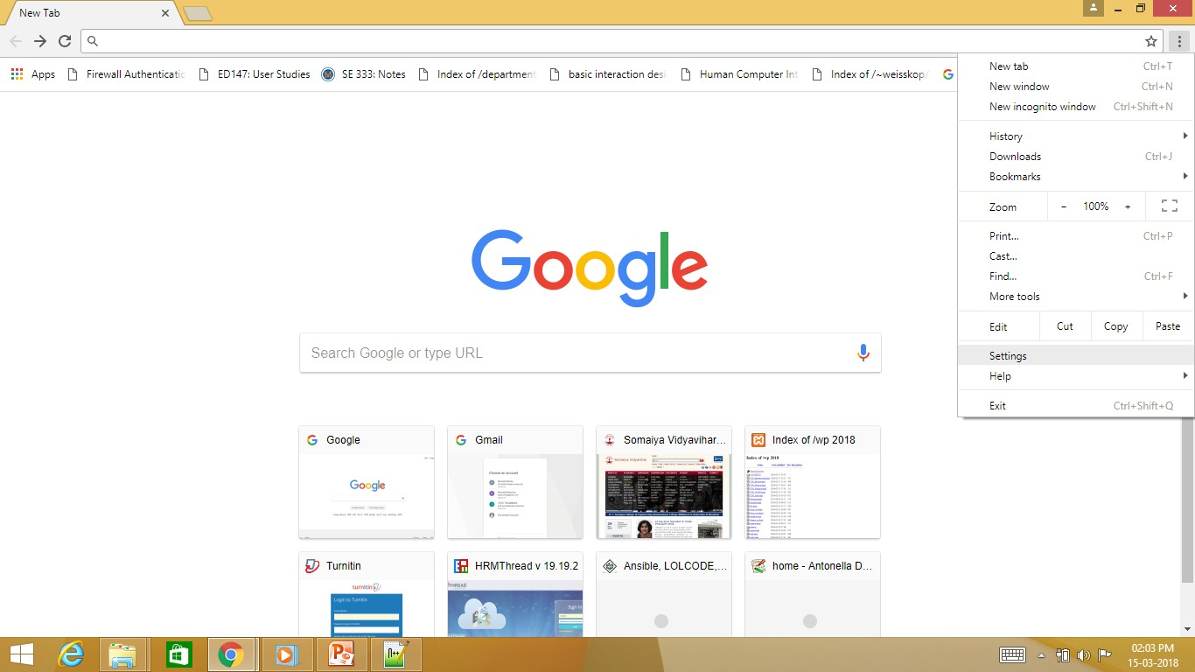
Enabling - Chrome
Step 1 : Choose Setting
8

Slide 9
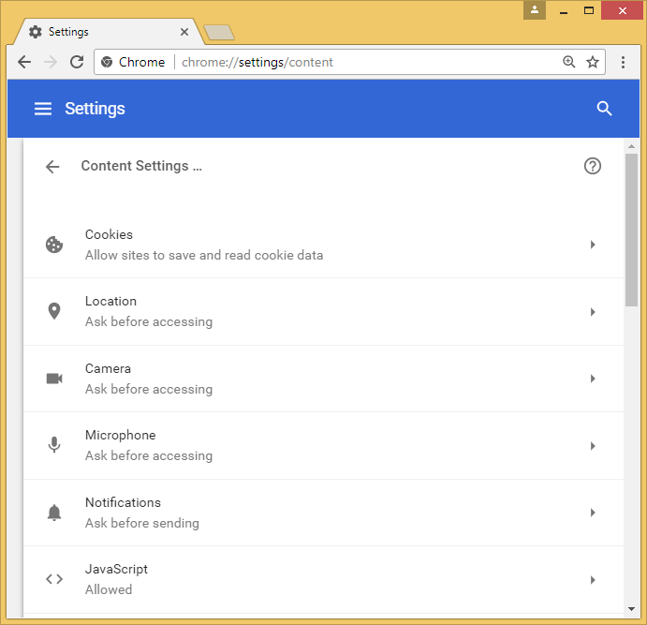
Enabling - Chrome
Step 3 : Privacy & Security -> Content Settings-Enable
Javascript
9

Slide 10
Comments
Single Line Comment
It is represented by double forward slashes (//). It can be used
before and after the statement.
Multiline Comment
It can be used to add single as well as multi line comments. So,
it is more convenient.
/* your code */
10

Slide 11
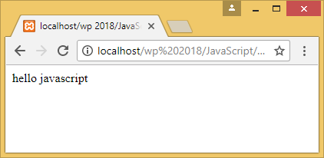
A Simple Script
Ex2.html
<html>
<body>
<script>
/* Sample Program for comment */
// It is single line comment document.write("hello javascript");
on Output device
//Printing Message
</script>
</body>
</html>
11

Slide 12
Basic Features
You can use as many <script> tags as you like in both the
<head> and <body> and they are executed sequentially.
Script Execution
Top-down
<head> before <body>
Can’t forward reference outside a <script> tag
JavaScript is case sensitive
Whitespace is generally ignored in JavaScript statement
X = X + 1 same as X=X+1
12

Slide 13
Statements
A script is made up of individual statements.
JavaScript statement are terminated by returns / semi-colons (;)
Prefer to use semi-colons
Statements are group together using curly braces { }.
Used for control structures and functions
13

Slide 14
JavaScript Can Change HTML Content
One of many JavaScript HTML methods is getElementById().
This example uses the method to "find" an HTML element (with id="demo") and changes the element content (innerHTML) to "Hello JavaScript":
Example
document.getElementById("demo").innerHTML = "Hello JavaScript";
14

Slide 15
JavaScript Can Change HTML Styles (CSS)
Changing the style of an HTML element, is a variant of changing an HTML attribute:
Example
document.getElementById("demo").style.fontSize = "35px";
15

Slide 16
JavaScript Can Hide HTML Elements
Hiding HTML elements can be done by changing the display style:
Example
document.getElementById("demo").style.display = "non e";
16

Slide 17
JavaScript Can Show HTML Elements
Showing hidden HTML elements can also be done by changing the display style:
Example document.getElementById("demo").style.display = "block";
17

Slide 18
JavaScript Where To
JavaScript in <head>
<head>
<script>
function myFunction() {
document.getElementById("demo").innerHTML = "Paragraph
changed.";
}
</script>
</head>
18

Slide 19
JavaScript Where To
JavaScript in <body>
<body>
<h1>A Web Page</h1>
<p id="demo">A Paragraph</p>
<button type="button" onclick="myFunction()">Try it</button>
<script>
function myFunction() {
document.getElementById("demo").innerHTML = "Paragraph changed.";
}
</script>
</body>
19

Slide 20
External JavaScript
Scripts can also be placed in external files:
External file: myScript.js function myFunction() {
document.getElementById("demo").innerHTML = "Paragraph changed.";
}
External scripts are practical when the same code is used in many different web pages.
JavaScript files have the file extension.js.
To use an external script, put the name of the script file in the src
(source) attribute of a <script> tag:
Example
<script src="myScript.js"></script>
20

Slide 21
JavaScript Display Possibilities
JavaScript can "display" data in different ways:
Writing into an HTML element, using innerHTML.
Writing into the HTML output using
document.write().
Writing into an alert box, using window.alert().
Writing into the browser console, using console.log().
21

Slide 22
JavaScript Display Possibilities
document.getElementById("demo").innerHTML = 5
+ 6;
document.write(5 + 6);
<button type="button" onclick="document.write(5
+ 6)">Try it</button>
window.alert(5 + 6);
console.log(5 + 6);
22

Slide 23
Variables
Variables are containers for storing data values.
These unique names are called identifiers.
Identifiers can be short names (like x and y) or more
descriptive names (age, sum, total).
23

Slide 24
Cont…
The general rules for constructing names for variables
(unique identifiers) are:
Names can contain letters, digits, underscores, and dollar signs.
Names must begin with a letter
Names can also begin with $ and _ (but we will not use it in this tutorial)
Names are case sensitive (y and Y are different variables)
Reserved words (like JavaScript keywords) cannot be used as
names
24

Slide 25
Cont…
Define a variable using the var statement
var x;
If undefined a variable will be defined on its first use
Variables can be assigned at declaration time
var x = 5;
Commas can be used to define many variables at once
var x, y = 5, z;
25

Slide 26
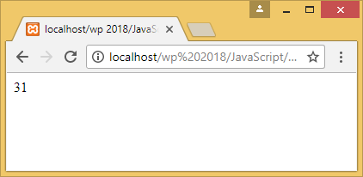
A Simple Script
Ex3.html
<html>
<body>
<script>
var myvar = 31;
document.write(myvar); document.write(Myvar);
</script>
</body>
</html>
26

Slide 27
JavaScript Reserved Words
 | abstract | arguments | await* | boolean
 | break | byte | case | catch
 | char | class* | const | continue
 | debugger | default | delete | do
 | double | else | enum* | eval
 | export* | extends* | false | final
 | finally | float | for | function
 | goto | if | implements | import*
 | in | instanceof | int | interface ₂₇

Slide 28
JavaScript Reserved Words
let* | long | native | new
null | package | private | protected
public | return | short | static
super* | switch | synchronized | this
throw | throws | transient | true
try | typeof | var | void
volatile | while | with | yield
Words marked with* are new in ECMAScript 5 and 6.

Slide 29
Data Types
Every variable has a data type that indicates what kind of
data the variable holds
Basic data types in JavaScript
Strings
Numbers
Boolean
Array
JavaScript has dynamic types. This means that the same variable can be used to hold different data types.

Slide 30
Numbers
JavaScript has only one type of numbers.
Numbers can be written with, or without decimals:
E.g.
var x1 = 34.00;
var x2 = -34;
Extra large or extra small numbers can be written with
scientific (exponential) notation.
E.g.
var y = 123e5;

Slide 31
Strings
A string (or a text string) is a series of characters
Strings are written with quotes. You can use single or double quotes
E.g. (“thomas”, ‘x’, “Who are you?”)
Strings may include special escaped characters
E.g. ‘This isn\’t hard’
Strings may contain some formatting characters
“Here are some newlines \n\n\n and tabs \t\t\t yes!”
Whitespace has no meaning outside of quotation marks
var foo = ’ h e l l o world ’;

Slide 32
Boolean
Booleans can only have two values: true or false.
Booleans are often used in conditional testing.

Slide 33
Type Conversion
JavaScript typeof operator to
find
the type of a
JavaScript variable
E.g.
typeof (3)
typeof (3 + 4)
// Returns "number"
// Returns "number"

Slide 34
Arrays
An array is a special variable, which can hold more than one
value at a time.
Creating array
var cars = [];
var cars = ["Saab", "Volvo", "BMW"];
Access the elements of an array by referring index number.
var name = car[1];
Array index starts from zero (0).

Slide 35
Cont…
The length property of an array returns the length of an array (the number of array elements).
E.g. cars.length;
Add a new element to an array is using the push method
E.g. cars.push(“swift”);

Slide 36
Arithmetic Operators
Operator | Description
+ | Addition
- | Subtraction
* | Multiplication
/ | Division
% | Modulus
++ | Increment
-- | Decrement

Slide 37
Assignment Operator
Operator | Example | Equivalent
= | x = y | x = y
+= | x += y | x = x + y
-= | x -= y | x = x - y
*= | x *= y | x = x * y
/= | x /= y | x = x / y
%= | x %= y | x = x % y

Slide 38
Comparison Operator
Operat or | Description
== | equal to
=== | equal value and equal type
!= | not equal
!== | not equal value or not equal type
> | greater than
< | less than
>= | greater than or equal to
<= | less than or equal to
? | ternary operator 38

Slide 39
Logical Operator
Operator | Description
&& | logical and
|| | logical or
! | logical not
39

Slide 40
Conditional Statement
if (hour < 18)
{
greeting = "Good day";
var hour = new Date().getHours(); var greeting;
if (hour < 18)
{
greeting = "Good day";
}
else
{
greeting = "Good
evening";
}
if (hour< 10) {
greeting = "Good morning";
} else if (hour < 20) {
greeting = "Good day";
} else {
greeting = "Good evening";
}
}
41

Slide 41
Loops
Loops can execute a block of code as long as a specified condition is true.
while loop loops through a block of code as long as a specified condition is true
Syntax
while (condition)
{
code block to be executed
}

Slide 42
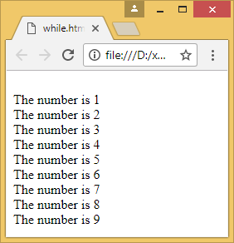
Example
<html>
<body>
<script>
var text = ""; var i = 1; while (i < 10)
{
document.write("<br> The number is " + i);
i++;
}
</script>
</body>
</html>

Slide 43
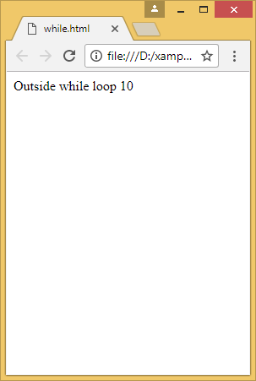
Example
<html>
<body>
<script>
var text = ""; var i = 10; while (i < 10)
{
document.write("<br> The number is " + i);
i++;
}
document.write(“Outside while loop “ + i);
</script>
</body>
</html>

Slide 44
Loops
Do-while loop will execute the code block once, before checking if the condition is true, then it will repeat the loop as long as the condition is true
do
{
code block to be executed
} while (condition);

Slide 45
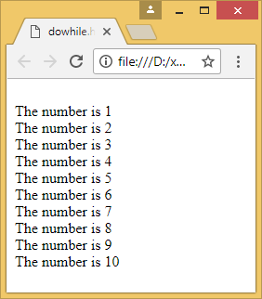
Example
<html>
<body>
<script>
var i = 1;
do
{
document.write("<br> The number is " + i);
i++;
} while (i < 10);
</script>
</body>
</html>

Slide 46
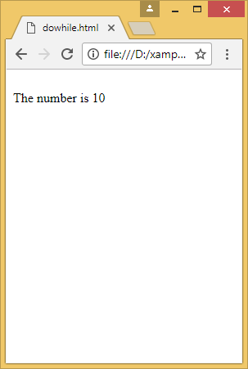
Example
<html>
<body>
<script>
var i = 10;
do
{
document.write("<br> The number is " + i);
i++;
} while (i < 10);
</script>
</body>
</html>

Slide 47
For Loop
The for loop is often the tool you will use when you want to create a loop
Syntax
for (statement 1; statement 2; statement 3) {
code block to be executed
}
Statement 1 is executed before the loop (the code block) starts.
Statement 2 defines the condition for running the loop (the
code block).
Statement 3 is executed each time after the loop (the code
block) has been executed.

Slide 48
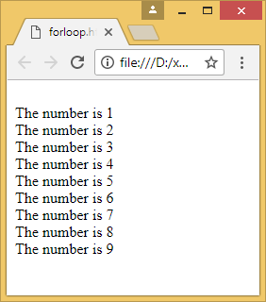
Example
html>
<body>
<script>
var i = 1;
for(i=1;i<10;i++)
{
document.write("<br> The number is " + i);
}
</script>
</body>
</html>

Slide 49
Switch Statement
Use the switch statement to select one of many blocks of code to
be executed.
switch(expression) {
Syntax
case n:
code block
break;
case n:
code block
break;
default:
code block
}
The switch expression is evaluated once.
The value of the expression is compared with the values of each case.
If there is a match, the associated block of code is executed.
50

Slide 50
Example
<script> let day;
switch (new Date().getDay()) { case 0:
day = "Sunday"; break;
case 1:
day = "Monday";
break;
case 2:
day = "Tuesday";
break;
case 3:
day = "Wednesday"; break;
case 4:
day = "Thursday"; break;
case 5:
day = "Friday"; break;
case 6:
day = "Saturday";
}
document.write("Today is " + day);
</script>

Slide 51
JavaScript Functions
A JavaScript function is a block of code designed to perform a
particular task.
A JavaScript function is executed when "something" invokes it (calls it).
function definition:
function functionName (parameters)
{
// function body;
}
Function calling:
nameOfThefunction (arguments);

Slide 52
Example
<!DOCTYPE html>
<html> <body>
<h1>JavaScript Functions</h1>
<p>Call a function which performs a calculation and returns the result:</p>
<p id="demo"></p>
<script>
let x = myFunction(4, 3); //function calling
document.getElementById("demo").innerHTML = x;
function myFunction(a, b) //function definition
{
return a * b;
}
</script> </body></html>

Slide 53

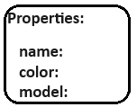
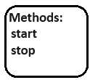
JavaScript Object Notation(JSON)
Object –
Logically all the data stored together under one name
It has properties and Methods.
Properties are the attributes of an Object.
Methods are actions that can be performed on objects.
All cars have the same properties, but the property values differ from car to car.
All cars have the same methods, but the methods are performed at different times.

Slide 54
Object creation
The properties are written as name:value pairs
(name and value separated by a colon).
EX. let car = {type:“Baleno", model:"500", color:"white"};

Slide 55
Creating objects in JavaScript
By object literal
You define properties and methods directly within curly braces {}
By creating instance of Object directly (using new keyword)
By using an object constructor (using new keyword)

Slide 56
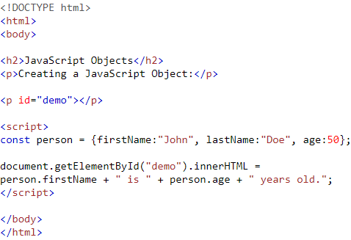
Creating object by literal

Slide 57
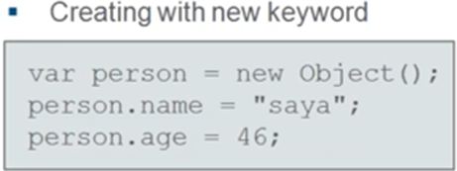
By creating instance of Object
The syntax of creating object directly is given below:
var objectname=new Object();
Here, new keyword is used to create object.
Example:
<html>
<body>
<script>
var emp=new Object();
emp.id=101;
emp.name="Ravi Joshi";
emp.salary=50000;
document.write(emp.id+" "+emp.name+" "+emp.salary);
</script>
</body></html>

Slide 58
By using an Object constructor
Here, you need to create function with arguments. Each argument value can be assigned in the current object by using ‘this’ keyword.
The this keyword refers to the current object.
Example:
<script>
function emp(eid,ename,esalary){
this.id=eid;
this.name=ename;
this.salary=esalary;
}
Var e=new emp(103,"Vimal Jaiswal",30000);
document.write(e.id+" "+e.name+" "+e.salary);
</script>

Slide 59
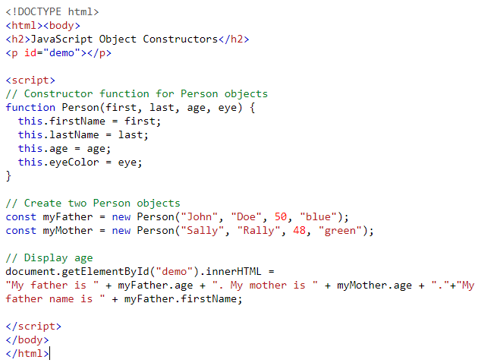

Slide 60
Javascript method
getElementById()
GetElementsByClassName()
getElementsByName
getElementsByTagName
JS innerHTML property

Slide 61
Document.getElementById()
The document.getElementById() method returns the element of specified id.
Example:
document.getElementById("demo").innerHTML = "Hello JavaScript";
<!DOCTYPE html>
<html>
<body>
<h2>What Can JavaScript Do?</h2>
<p id="demo">JavaScript can change HTML content.</p>
<button type="button" onclick='document.getElementById("demo").innerHTML = "Hello JavaScript!"'>Click Me!</button>
</body>
</html>

Slide 62
document.getElementsByName()
This method returns all the element of specified name.
syntax :
document.getElementsByName("name")
Example:
<script type="text/javascript">
function totalelements()
{
var allgenders=document.getElementsByName("gender");
alert("Total Genders:"+allgenders.length);
}
</script>
<form>
Male:<input type="radio" name="gender" value="male">
Female:<input type="radio" name="gender" value="female">
<input type="button" onclick="totalelements()" value="Total Genders">
</form>

Slide 63
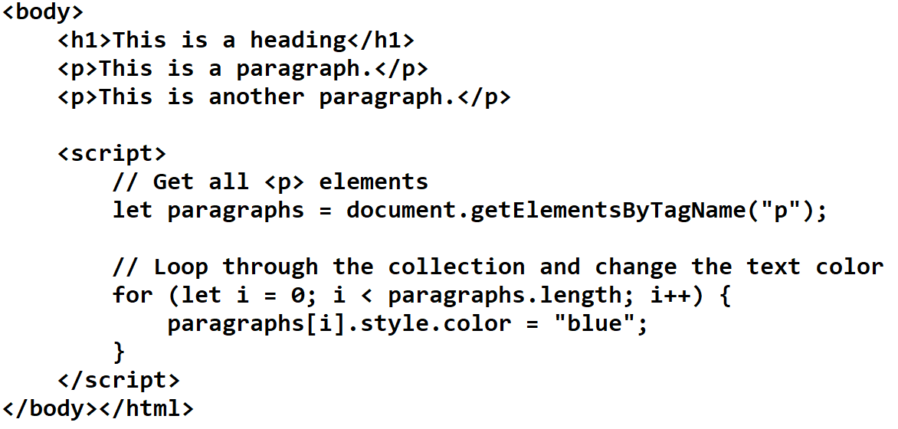
document.getElementsByTagName()
This method returns all the element of specified tag name.
Syntax:
document.getElementsByTagName(“p")
Example:

Slide 64
ParseInt()- String to Int conversion ParseFloat()- String to float conversion
Example:
<!doctype html>
<html>
<head><title></title></head>
<body>
<script>
var num1=prompt(“Enter the number");
document.write(typeof num1);
document.write(num1+9);
document.write("<br>");
document.write(parseInt(num1)+9);
</script>
</body>
</html>
var num1=parseInt(prompt(“Enter the number"));

Slide 65
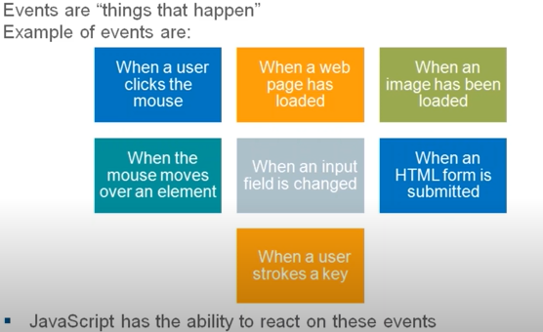
Document Object Model: Events

Slide 66
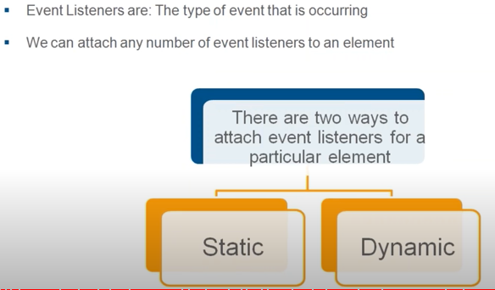
Document Object Model: Event Listeners

Slide 67
Statically
In JavaScript, you can add event listeners both statically (in your HTML markup) and dynamically (in your JavaScript code).
In HTML, you can add event listeners directly to elements using attributes like onclick, onmouseover, etc.
Example:
<button onclick="myFunction()">Click me</button>

Slide 68
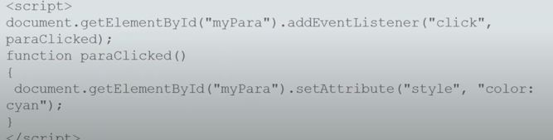
Dynamic method
In JavaScript, you can add event listeners to elements dynamically using the addEventListener() method
Syntax:
Element.addEventListener(event,function)

Slide 69
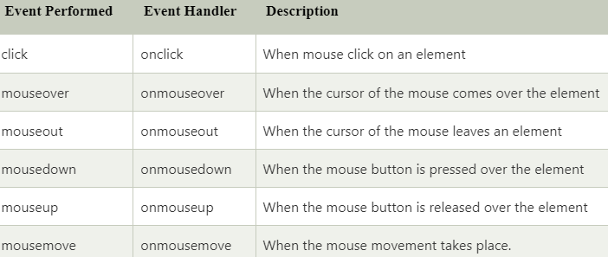
Common HTML Events
Mouse events:

Slide 70
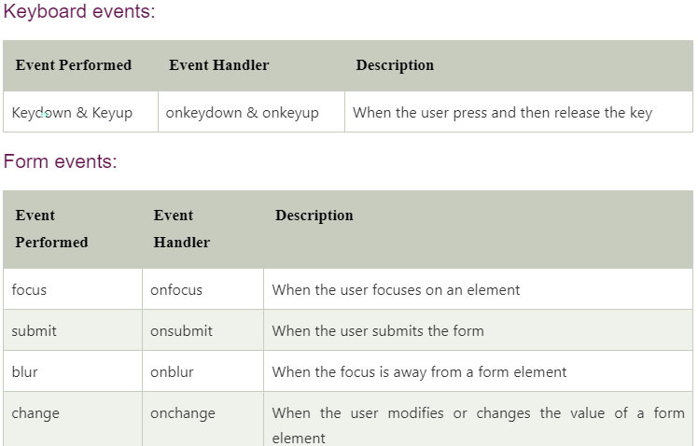

Slide 71
Click Event
<html>
<head
<meta charset="UTF-8”>>>
<meta name ="viewport" content-width=“device-width”>
<title> Javascript Events </title> </head>
<body>
<script language="Javascript" type="text/Javascript">
function clickevent()
{
document.write("This is Javascript Event demo");
}
</script>
<form>
<input type="button" onclick="clickevent()" value=“Click here"/>
</form>
</body></html>

Slide 72
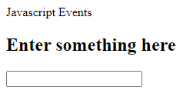
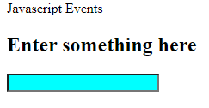
Mouse over Event
<body>
<script type="text/Javascript">
function mouseoverevent()
{
document.write("This is Mouse Over Event");
}
</script>
<p onmouseover="mouseoverevent()"> Keep cursor over me</p>
</body>
</html>

Slide 73
What can JavaScript Do?
Event handlers can be used to handle, and verify, user input, user actions, and browser actions:
Things that should be done every time a page loads
Things that should be done when the page is closed
Action that should be performed when a user clicks a
button
Content that should be verified when a user inputs data
And more ...

Slide 74
What can JavaScript Do?
Many different methods can be used to let JavaScript work with
events:
HTML event attributes can execute JavaScript code directly
HTML event attributes can call JavaScript functions
You can assign your own event handler functions to HTML elements
You can prevent events from being sent or being handled
And more ...

Slide 75
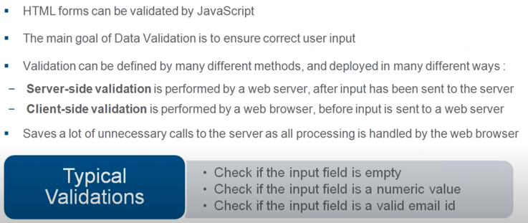
Form validation

Slide 76
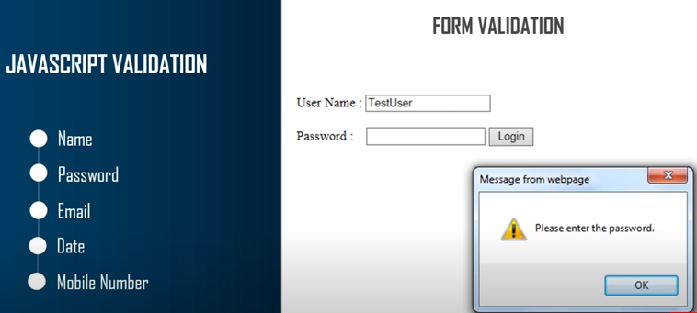

Slide 77

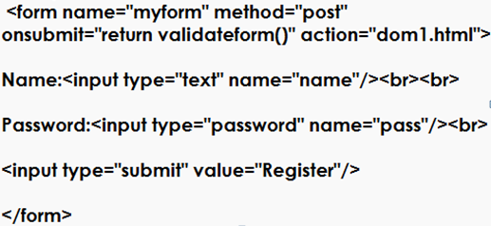
Example

Slide 78
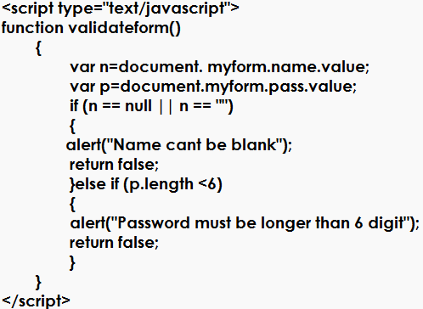

Slide 79
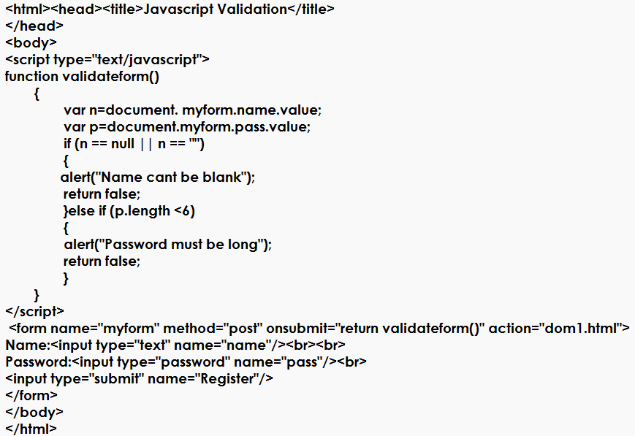
Complete example:

Slide 80
JavaScript Errors - Throw and Try to Catch
The try statement lets you test a block of code for errors.
The catch statement lets you handle the error.
The throw statement lets you create custom errors.
The finally statement lets you execute code, after try and
catch, regardless of the result.
When executing JavaScript code, different errors can occur.
Errors can be coding errors made by the programmer, errors due to wrong input, and other unforeseeable things.

Slide 81
JavaScript Errors - Throw and Try to Catch
Example<!DOCTYPE html>
<html>
<body>
<h2>JavaScript Error Handling</h2>
<p id="demo"></p>
<script>
try {
adddlert("Welcome guest!");
}
catch(err) {
document.getElementById("demo").innerHTML = err.message;
}
</script></body></html>

Slide 82
JavaScript Throws Errors, finally
When an error occurs, JavaScript will normally stop and generate an error message.
The technical term for this is: JavaScript will throw an exception (throw an error).
JavaScript will actually create an Error object with two
properties: name and message.
The finally statement lets you execute code, after try and catch, regardless of the result

Slide 83
JavaScript Debugging
Code Debugging
Programming code might contain syntax errors, or logical errors.
Many of these errors are difficult to diagnose.
Often, when programming code contains errors, nothing will happen. There are no error messages, and you will get no indications where to search for errors.
Searching for (and fixing) errors in programming code is called code debugging.
65

Slide 84
JavaScript Debugging
JavaScript Debuggers
Debugging is not easy. But fortunately, all modern browsers have a built-in JavaScript debugger.
Built-in debuggers can be turned on and off, forcing errors to be reported to the user.
With a debugger, you can also set breakpoints (places where code execution can be stopped), and examine variables while the code is executing.

Slide 85
Best Practices
Avoid global variables, avoid new, avoid ==, avoid eval()
Avoid Global Variables
Minimize the use of global variables.
This includes all data types, objects, and functions.
Global variables and functions can be overwritten by other scripts.
Use local variables instead

Slide 86
Best Practices
Always Declare Local Variables
All variables used in a function should be declared as local variables.
Local variables must be declared with the var keyword or the let keyword, otherwise they will become global variables.
Strict mode does not allow undeclared variables.

Slide 87
Best Practices
Declarations on Top
It is a good coding practice to put all declarations at the top of
each script or function.
This will:
Give cleaner code
Provide a single place to look for local variables
Make it easier to avoid unwanted (implied) global variables
Reduce the possibility of unwanted re-declarations
By default, JavaScript moves all declarations to the top

Slide 88
Best Practices
Initialize Variables
It is a good coding practice to initialize variables when you declare them.
This will:
Give cleaner code
Provide a single place to initialize variables
Avoid undefined values

Slide 89
Best Practices
Never Declare Number, String, or Boolean Objects
Always treat numbers, strings, or booleans as primitive values. Not as objects.
Declaring these types as objects, slows down execution speed, and produces nasty side effects

Slide 90
Best Practices
Don't Use new Object()
Use {} instead of new Object()
Use "" instead of new String()
Use 0 instead of new Number()
Use false instead of new Boolean()
Use [] instead of new Array()
Use /()/ instead of new RegExp()
Use function (){} instead of new Function()

Slide 91
Best Practices
Don't Use new Object(): Examples
var x1 = {};
var x2 = ""; var x3 = 0; var x4 = false; var x5 = []; var x6 = /()/;
// new object
// new primitive string
// new primitive number
// new primitive boolean
// new array object
// new regexp object
var x7 = function(){}; // new function object

Slide 92
JavaScript Date Objects
JavaScript new Date()
Example:
var d = new Date();
Sat Aug 17 2019 18:46:55 GMT+0530 (India Standard Time)
Date objects are created with the new Date() constructor.
There are 4 ways to create a new date object:
new Date()
new Date(year, month, day, hours, minutes, seconds, milliseconds)
new Date(milliseconds)
new Date(date string)

Slide 93
JavaScript Date Formats
JavaScript Date Input
There are generally 3 types of JavaScript date input formats:
Type | Example
ISO Date | "2015-03-25" (The International Standard)
Short Date | "03/25/2015"
Long Date | "Mar 25 2015" or "25 Mar 2015"

